Slide 1
Security Tool Presentation
24th April 2017
ENPM 686 Information Assurance
Professor Edward Condon
TA Byron Stancil

Slide 2

PEEL BACK THE LAYERS OF YOUR NETWORK IN MINUTES

Slide 3
What is Security Onion?
Security Onion is a FREE Linux distro for:
intrusion detection
network security monitoring
log management

Slide 4
What is an IDS (Intrusion Detection System)
It’s a snapshot in time.
Is usually passive in nature
Has a reputation for false positive.

Slide 5
The Beauty of Network Security Monitoring
IDS is just not enough . Its not enough to take care of problem what’s going bad on your network.
We may know that something went wrong but what went wrong is unclear.
So, the solution possibly is Network Security Monitoring. This is at much higher level than IDS

Slide 6
Network Security Monitoring
Requires capture and storage of large amount of data.
Is concerned with the process of reconstructing a network event.
Is based on live IP data capture
Whether you’re tracking an adversary or trying to keep malware at bay. NSM provides context, intelligence and situational awareness of your network.

Slide 7
What data does it give me?
Full packet capture from netsniff-ng
Alert data
NIDS alerts from Snort/Suricata
HIDS alerts from OSSEC
Powerful analysis tools.

Slide 8
Full Packet Capture
Full Packet Capture is like video Camera for your network but, better because,
Not only it can tell us who came and went, but also
Exactly where they went or what they brought or took with them
Exploits payload
Phishing Emails
Insiders Threat

Slide 9
NIDS and HIDS
Network-based and Host-based intrusion Detection System (IDS) analyze network traffic or host systems respectively, and provide log and alert data for detected events and activity.

Slide 10
Analysis Tools
With full packet capture, IDS logs and data, there is a daunting amount of data available at the analyst’s fingertips.
Security Onion integrates the tools to make the task easier.

Slide 11







What software is included in Security Onion?
Security Onion is based on all flavors of Ubuntu and includes:
and many other security tools!

Slide 12
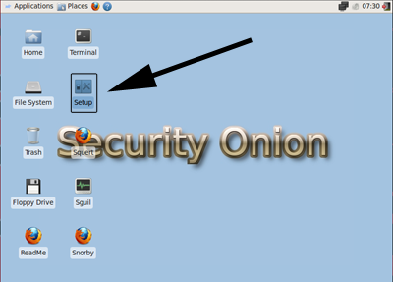
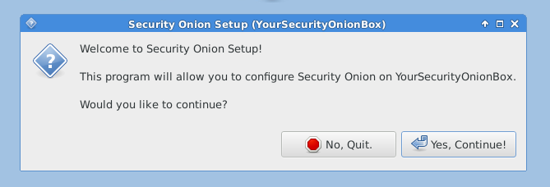
What does it look like?

Slide 13
Lets see how Snorby works

Slide 14


Slide 15
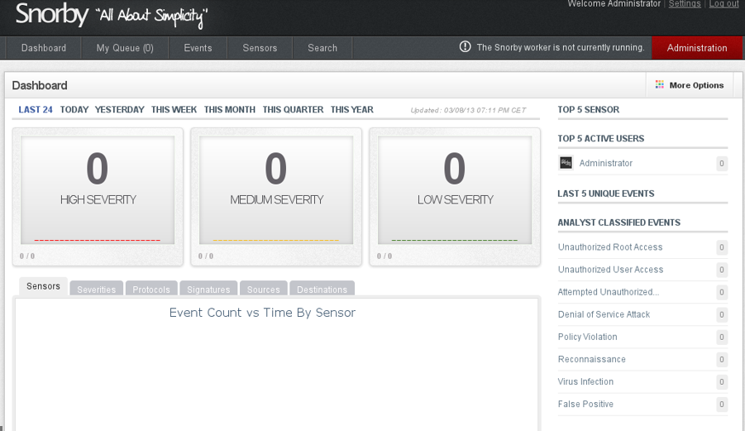
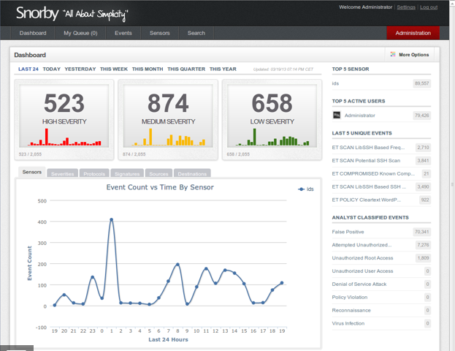
Screenshots

Slide 16
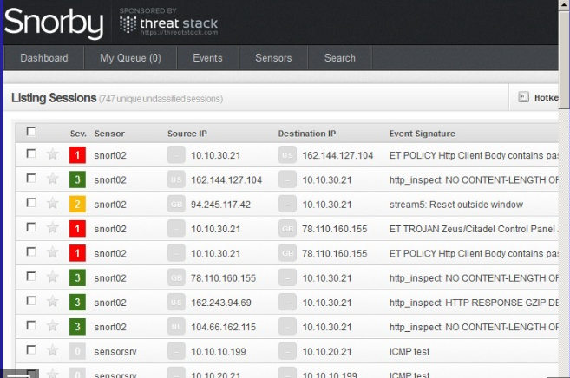
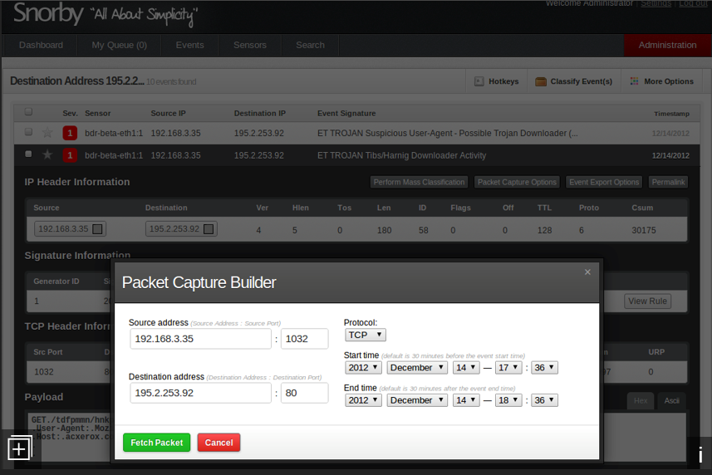
Screenshots

Slide 17
Squert
Data Types
Squert gives you access to the following data types:
NIDS alerts
HIDS alerts
Asset data from PRADS (if PRADS and pads_agent are enabled)
HTTP logs from Bro (if http_agent is enabled)

Slide 18
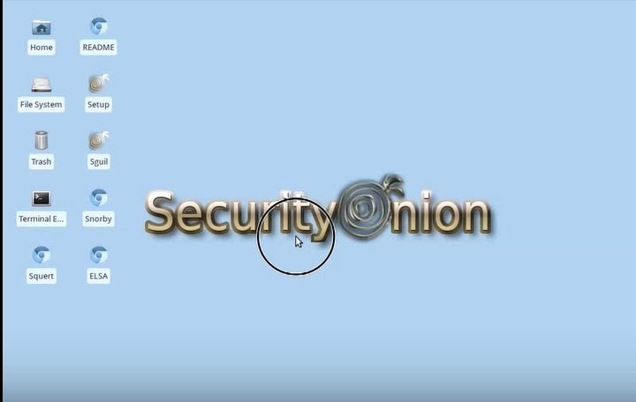

Slide 19
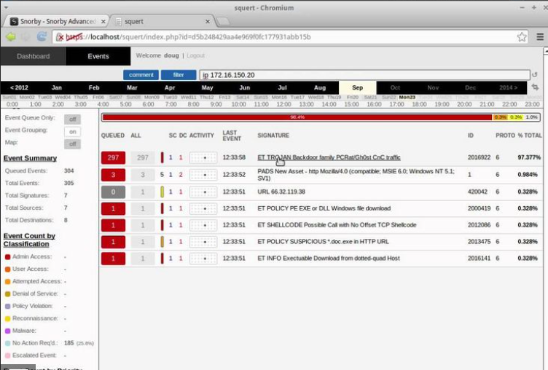
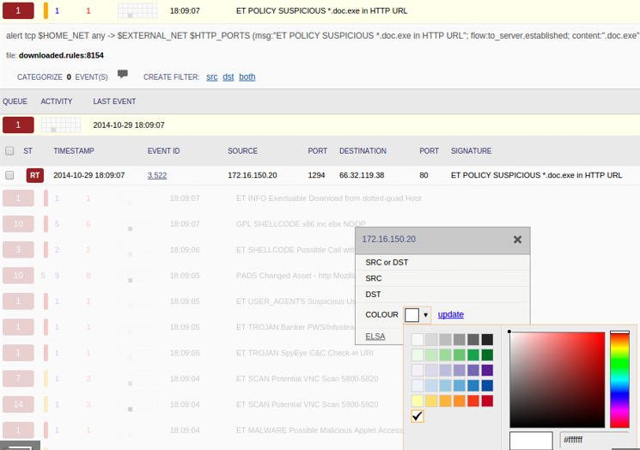
Screenshots

Slide 20
Overview of Security Onion
Full-packet Capture
NIDS and HIDS
Powerful analysis tools

Slide 21

Khushali Dalal
Pragya Gupta

Slide 22
References
https://github.com/Security-Onion-Solutions/security-onion/wiki
https://securityonion.net/
http://www.drchaos.com/ultimate-guide-to-installing-security-onion-with-snort-and-snorby/
https://www.youtube.com/watch?v=dyLbgrdagaA&list=PLMN5wm-C5YjyieO63g8LbaiWTSJRj0DBe
https://www.youtube.com/watch?v=mazSRVFYmLQ
https://www.youtube.com/watch?v=KJ9zt9SLI3A

